Slide 1
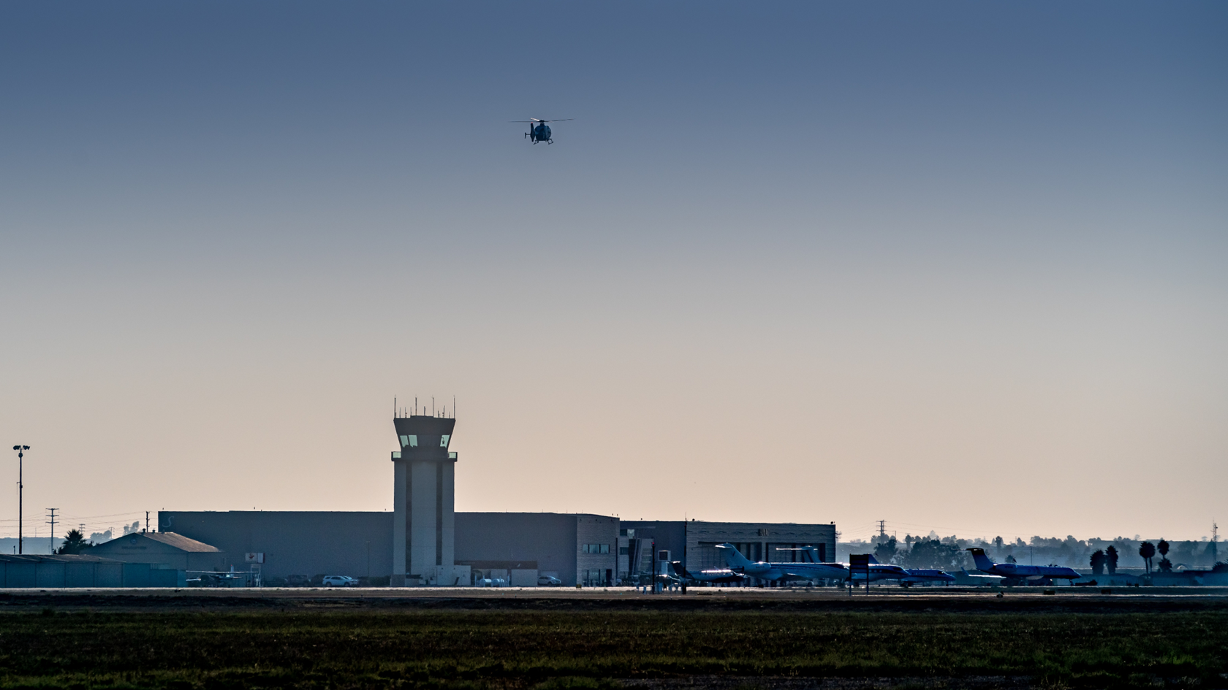
Camarillo Airport
Redevelopment Request for Proposal
OPEN HOUSE
June 16, 2026

Slide 2
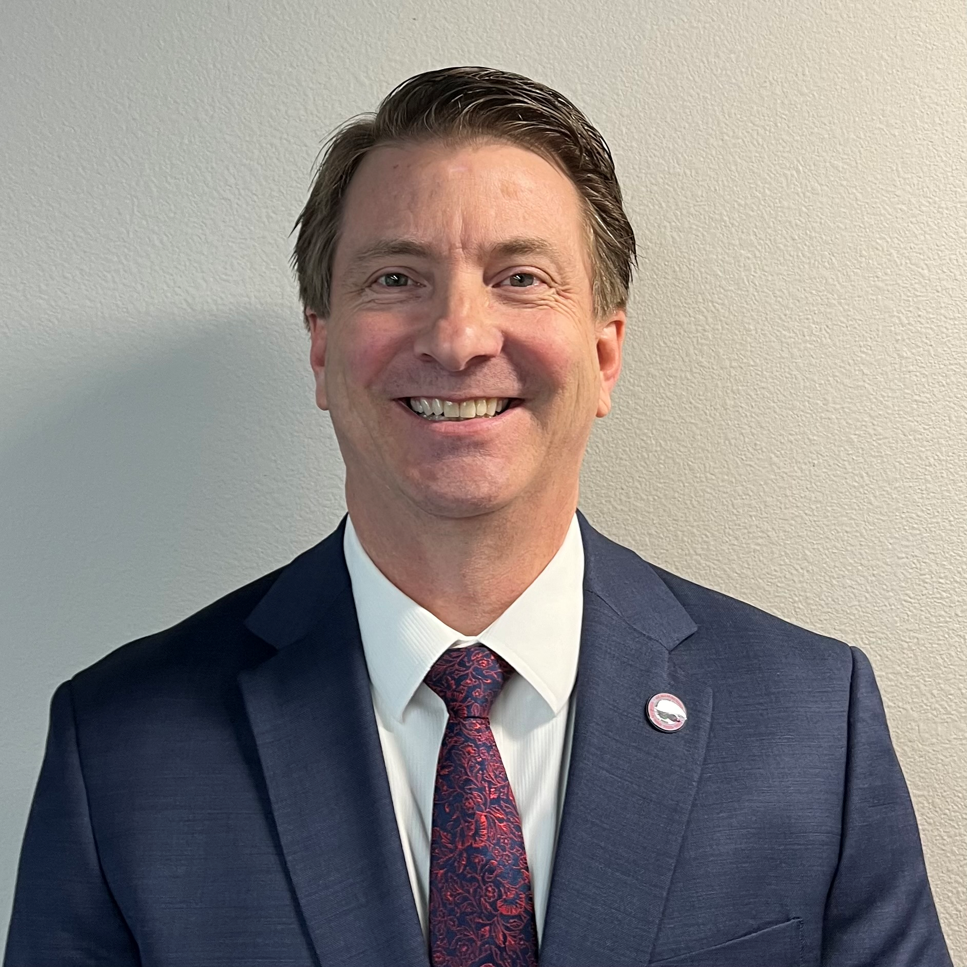
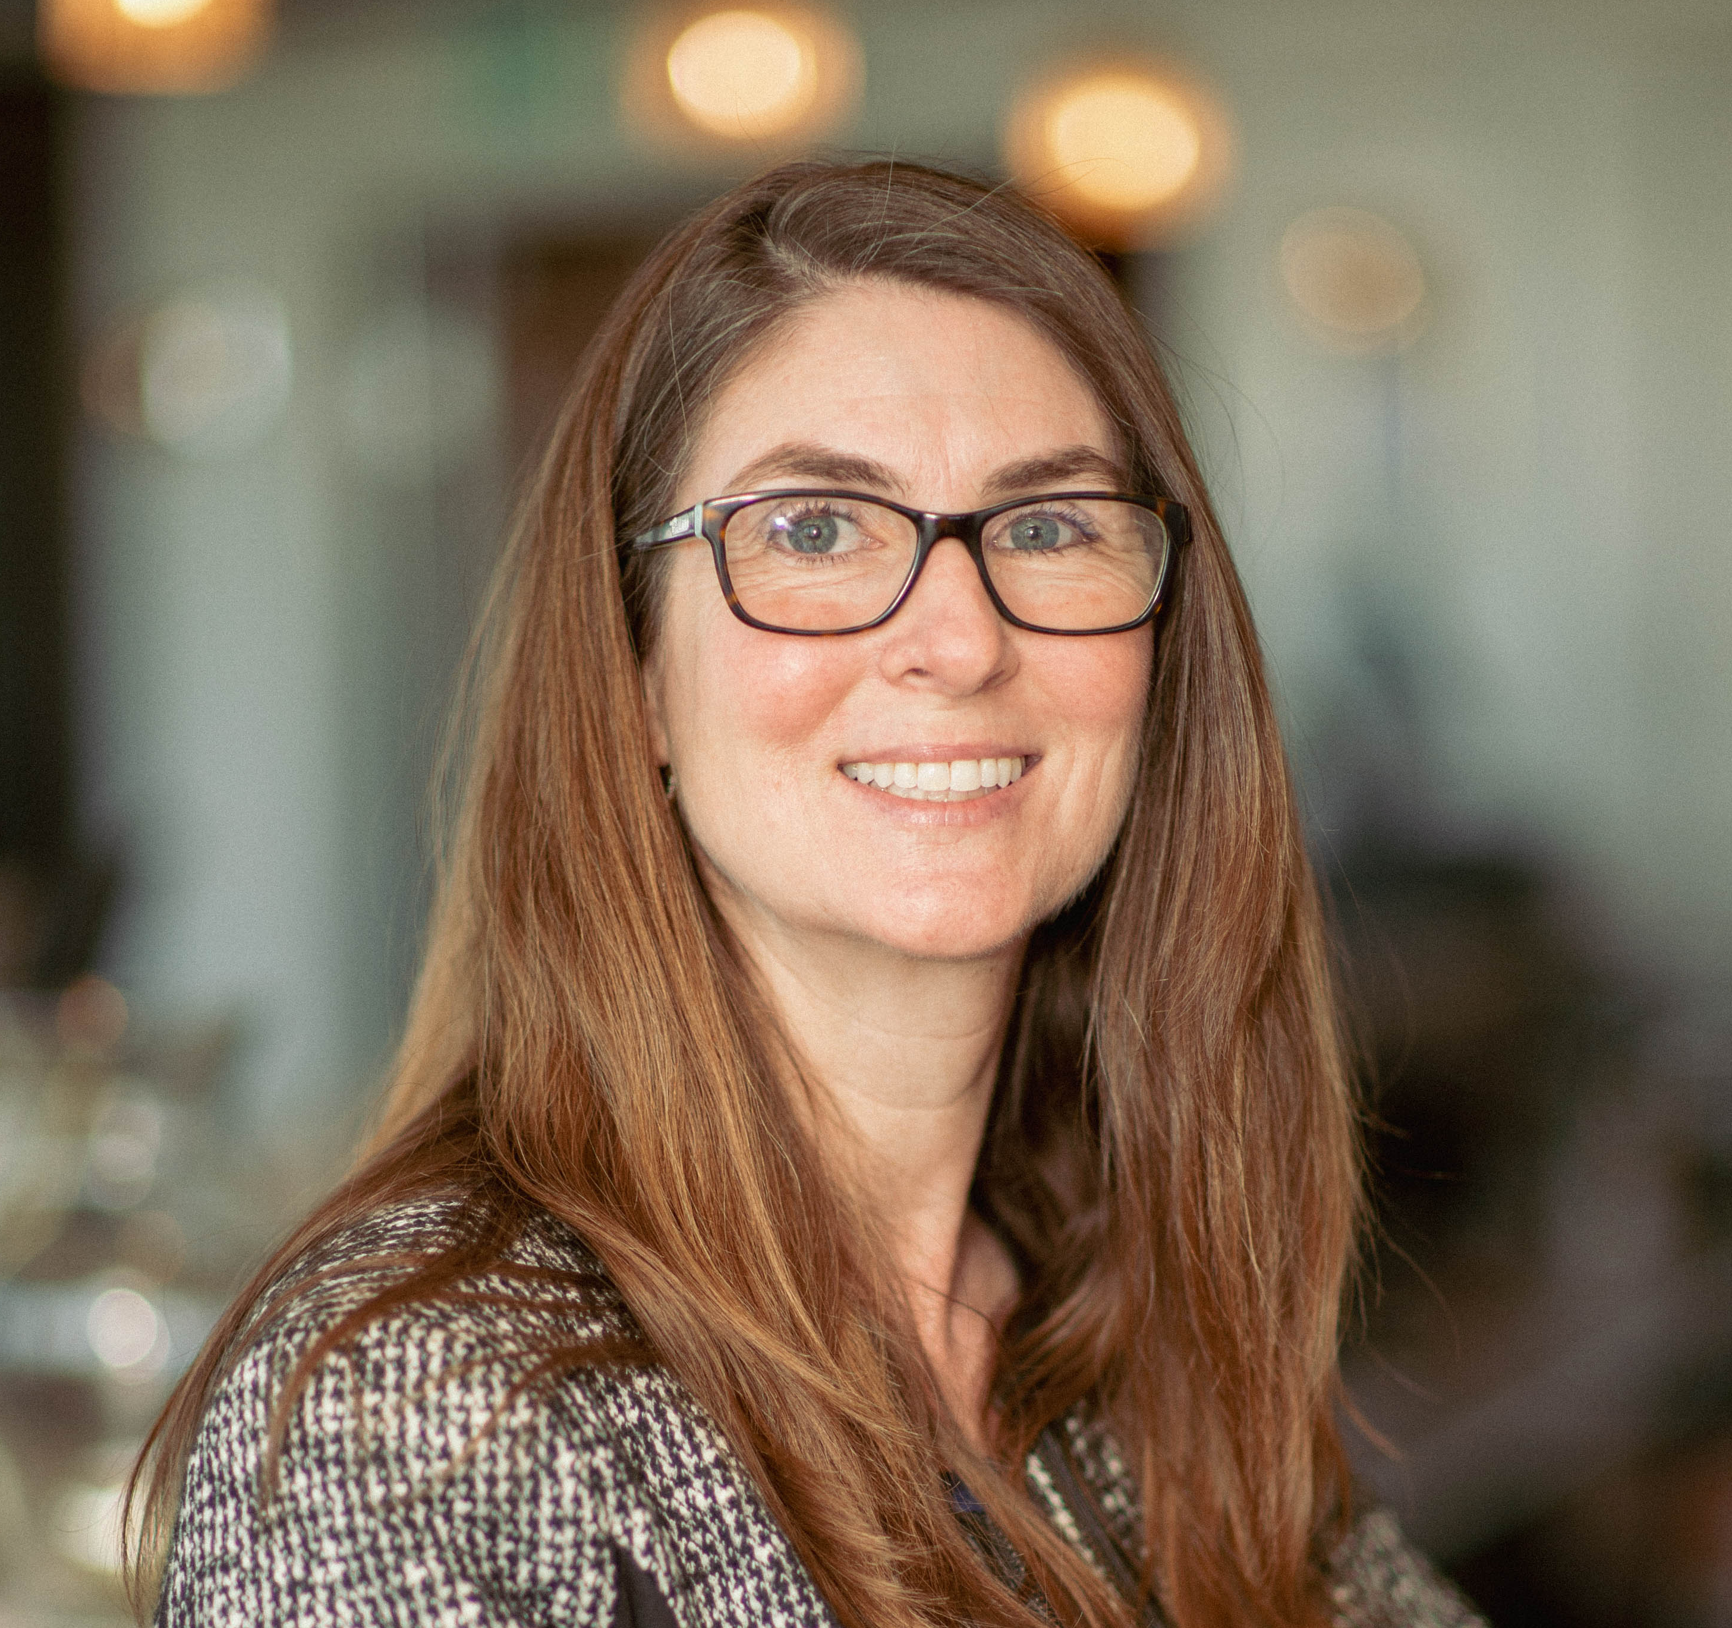
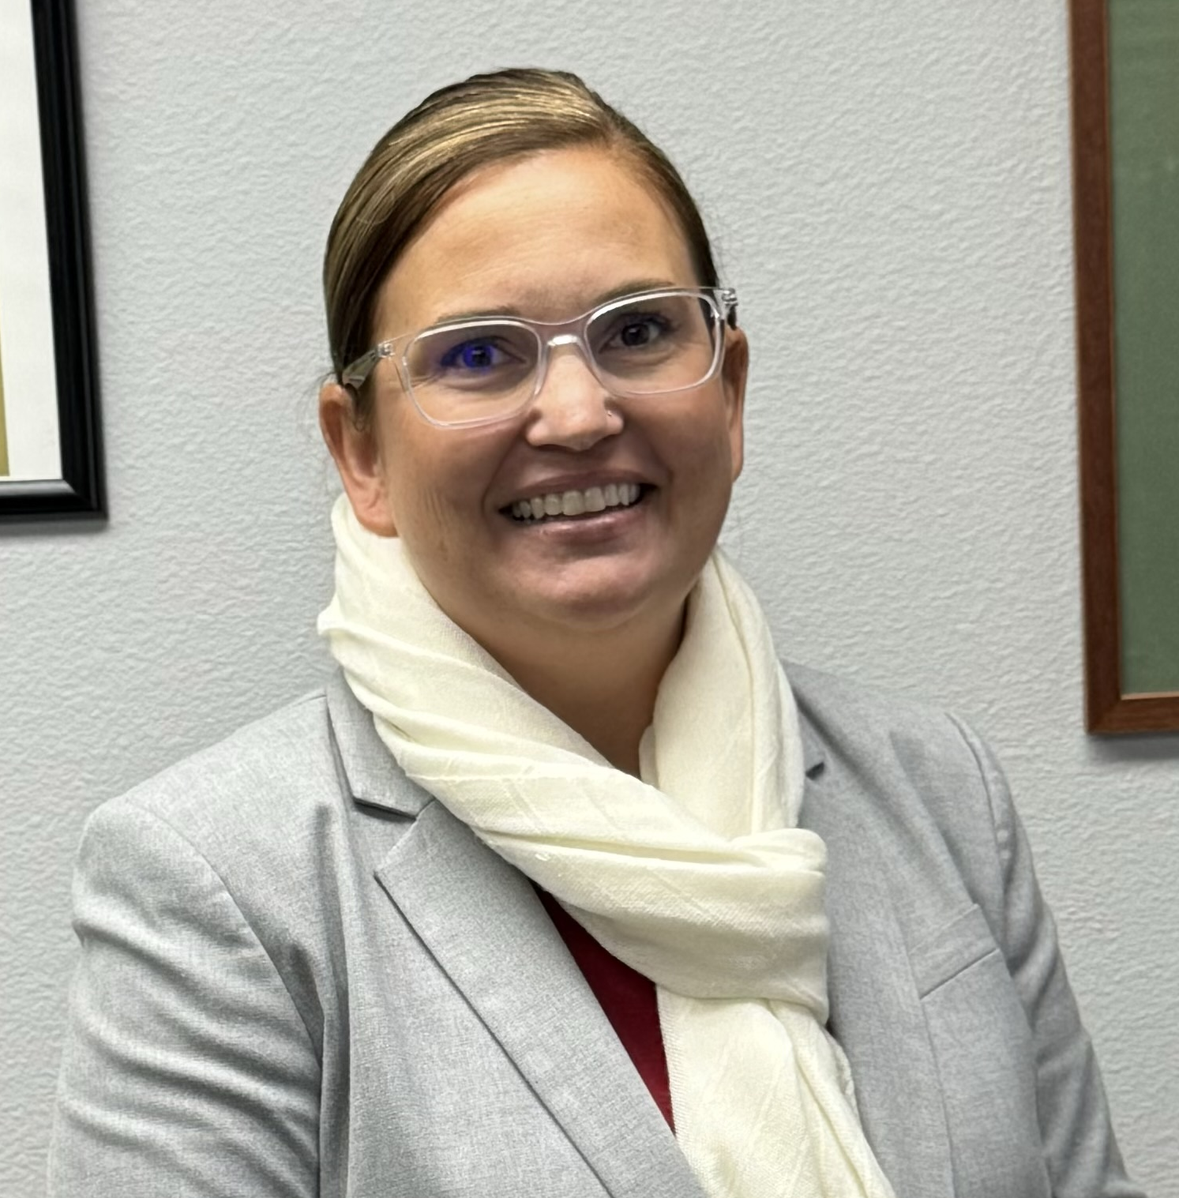
INTRODUCTIONS
Keith Freitas
Director of Airports
Erin Powers
Deputy Director
Jannette Jauregui
Communications & Engagement Manager

Slide 3
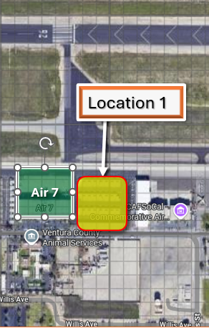
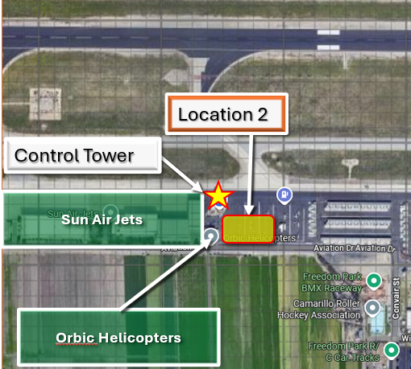
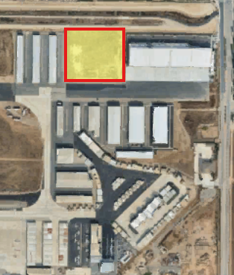


1.9 Acre Redevelopment Site
4.1 Acre Redevelopment Site
5 acre GA Hangar Relocation Area

Slide 4
AGENDA
  6:00 pm – Welcome / Agenda/ Question Cards
- Erin Powers– Deputy Director of Airports
  How We Got Here
  - Keith Freitas – Director of Airports
    Department’s Current Efforts to Address Noise Concerns
- Jannette Jauregui – Community & Engagement
    Request For Proposal Process /Next Steps
    - Keith Freitas – Director of Airports
    - Erin Powers– Deputy Director of Airports
    Misinformation & FAQ
  - Jannette Jauregui – Community & Engagement
    Break – Collection of Question Cards
    Audience Questions/Answers
  - Jannette Jauregui – Community & Engagement

Slide 5
Code of Conduct
The County is committed to ensuring that all participants can fairly and clearly share ideas, comments, and concerns about redevelopment at the Camarillo Airport. To provide a safe and equitable process, please remember to:
Treat each other with kindness and respect including your neighbors, the moderators, and the panel.
Respect the format of the meeting.
Maintain a conversational tone.

Slide 6
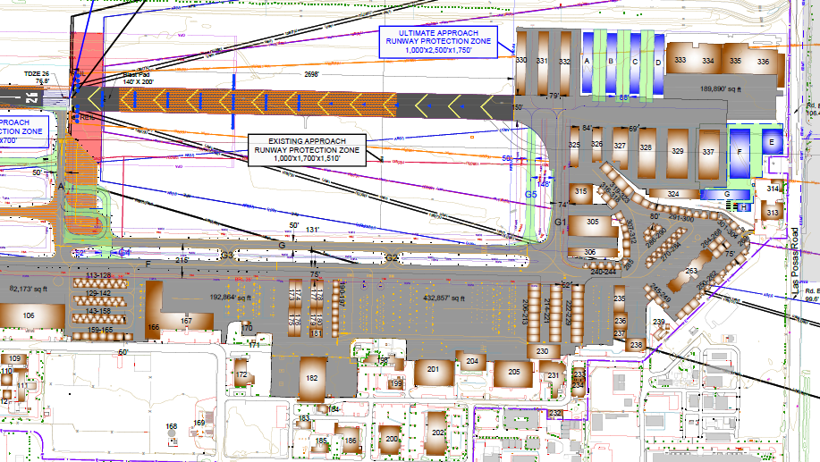
How We Got Here
  Governing Documents
  Planning Studies
  Feedback from Community & Stakeholders

Slide 7
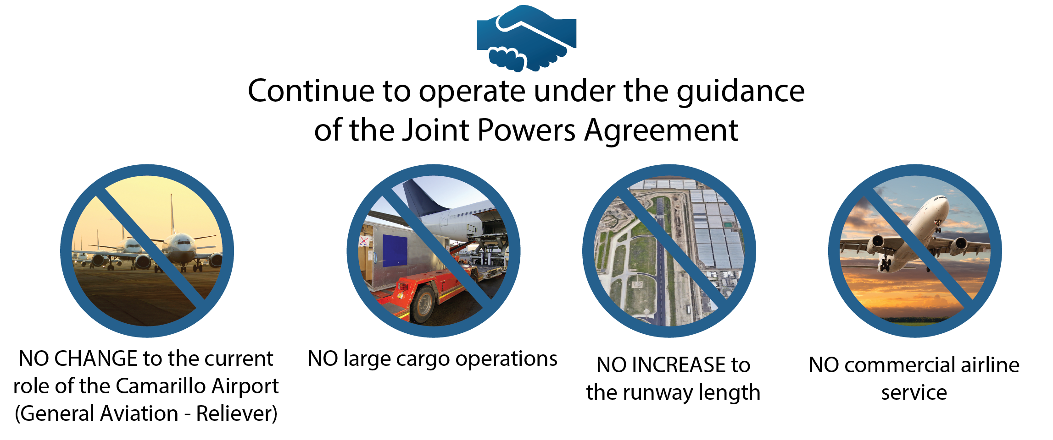
The Department of Airports remains committed to the agreement formed between the City and County in 1976.
Notes:
ADD SUPERVISOR LONG BOS VIDEO

Slide 8
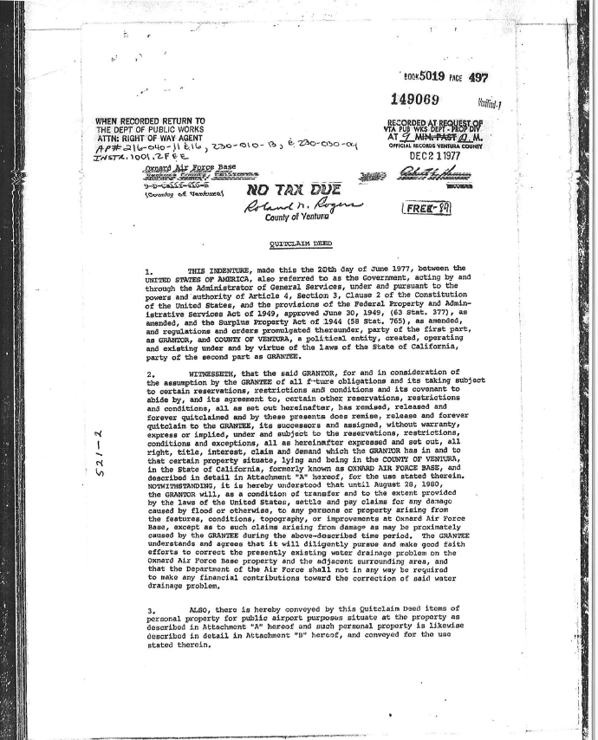
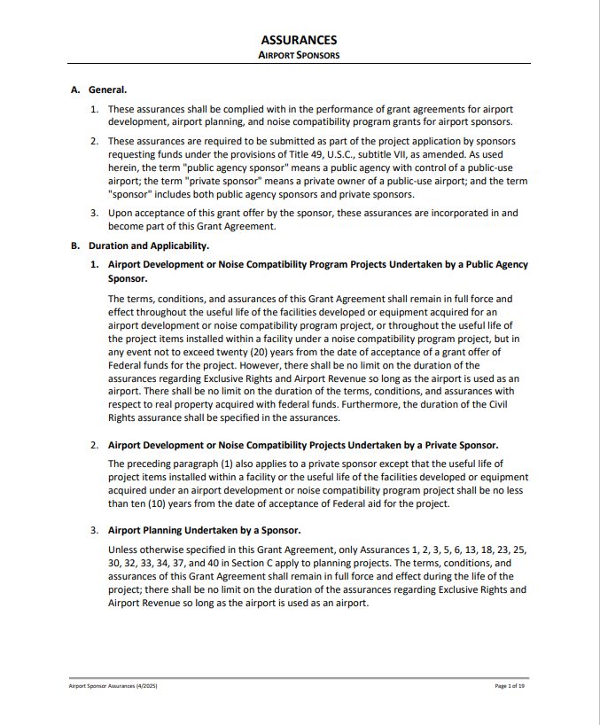
VENTURA COUNTY AIRPORT OBLIGATIONS
1977 Deed Requirements:
Requires the Grantee (County) to agree that it will “keep the airport open to all types, kinds, and classes of aeronautical use without discrimination between such types, kinds and classes” and it “….shall be used for public airport purposes for the use and benefit of the public, on reasonable terms and without unjust discrimination and without grant or exercise of any exclusive right for the use of the airport….and that it shall be maintained for the use and benefit of the public at all times in good and serviceable condition.. ”.
Airport Grant Assurances:
Grant Assurance 22 requires the Sponsor to “make the airport available as an airport for public use on reasonable terms and without unjust discrimination to all types, kinds and classes of aeronautical activities”. On this guidance the Sponsor must fairly offer development opportunities to all potential users.
Grant Assurance 24 also requires the sponsored airport to be as self-sustaining as possible in its operations and for that reason DOA pursues uses for its property to generate income for its operating needs without the use of County General Fund monies (including property taxes).

Slide 9
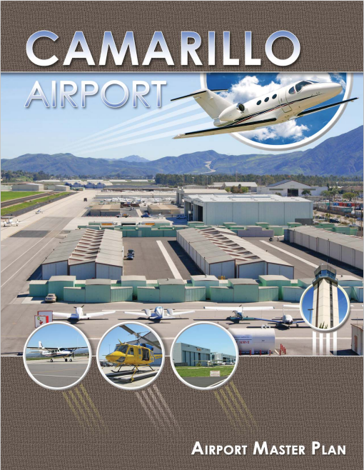
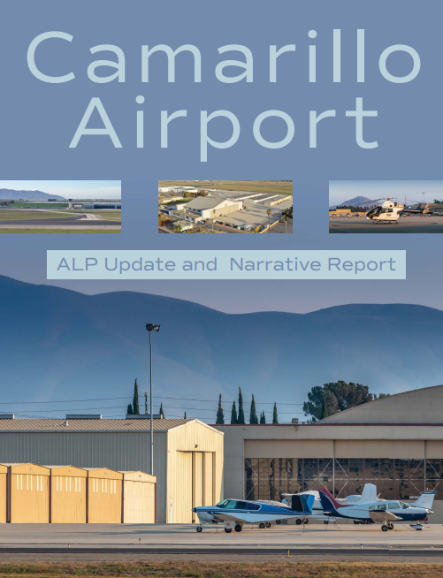
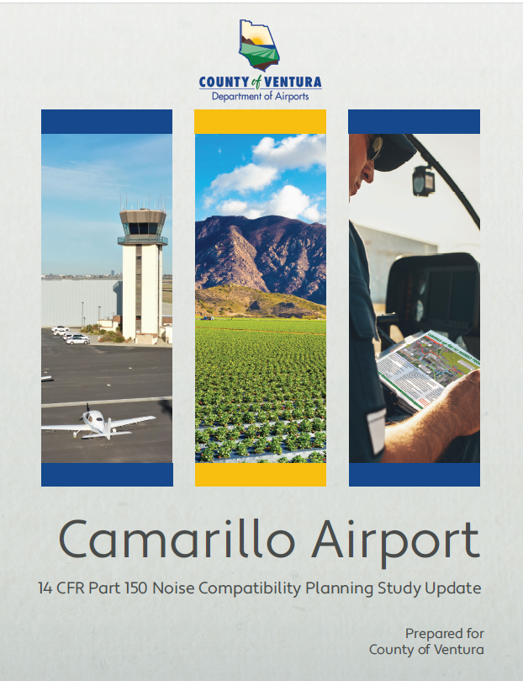
REPAIR / RE-DEVELOPMENT / DEVELOPMENT
CONSISTENT WITH LONG TERM PLANNING STUDIES:
2011 Master Plan Update
2022-2025 CMA Airport Layout Plan Update
2023-2026 CMA Noise Study

Slide 10
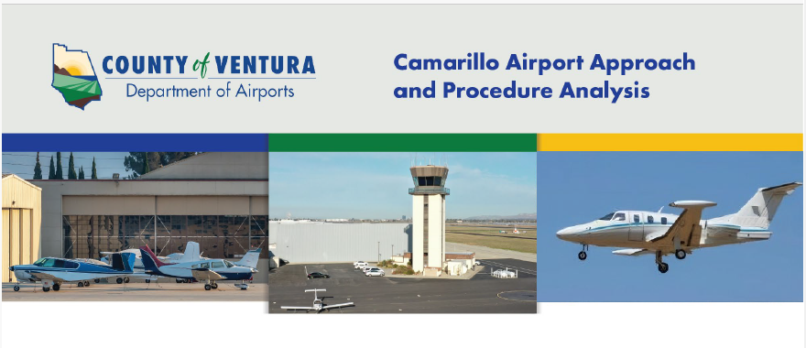

Slide 11
What is the Department of Airports already doing to address noise concerns?
The Ventura County Department of Airports:
  Hired a Communications Engagement Manager
  Expanded and enhanced public outreach/communication
  Implemented the Fly Friendly VC Noise Program
  Purchased noise flight tracking and comment software
  Holds regular meetings/updates with City of Camarillo
  Expanded Fly Friendly VC to include jet-specific information
  Updated ATIS message, Chart Supplement for preferred runway use program
  Expedited evaluation of alternative approach courses and glide paths

Slide 12
Request for Proposal (RFP) Process
  Complete Multi-year Planning Studies
  Notify & Coordinate RFP Scope with Airport Advisory Bodies & Public
  Develop RFP Selection Criteria Utilizing Prior Community & Stakeholder Feedback (aka Balancing of Interests)
  Issue RFP

Slide 13
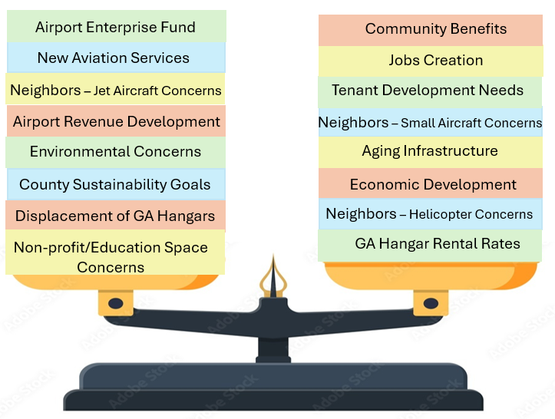
Selection Criteria Development
= A BALANCING OF INTERESTS

Slide 14
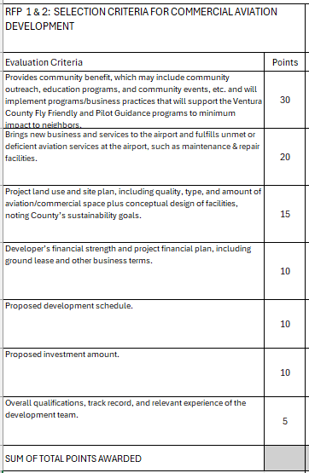
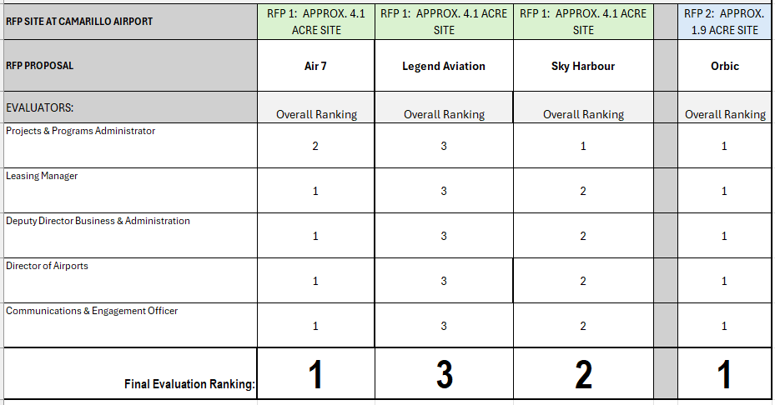
Development Proposal Rankings

Slide 15
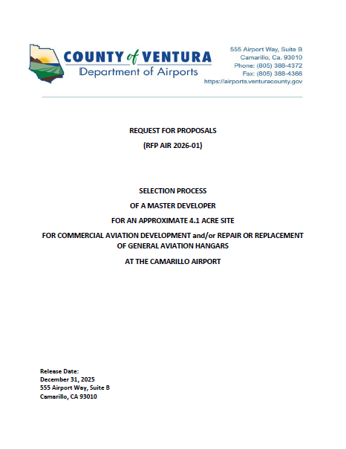
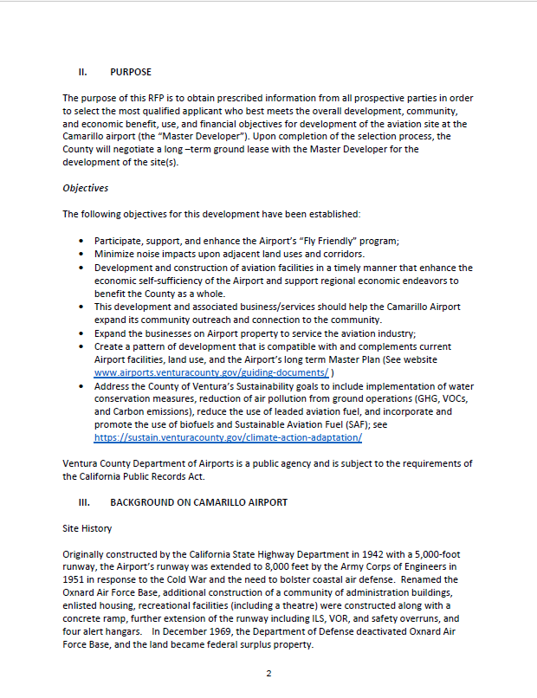
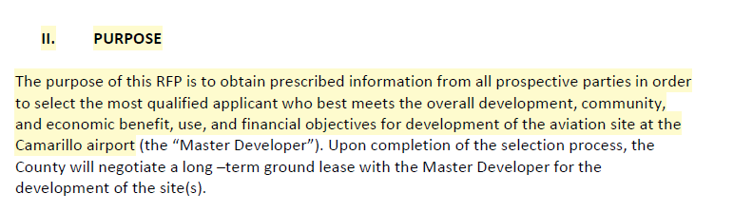
Purpose of RFP

Slide 16
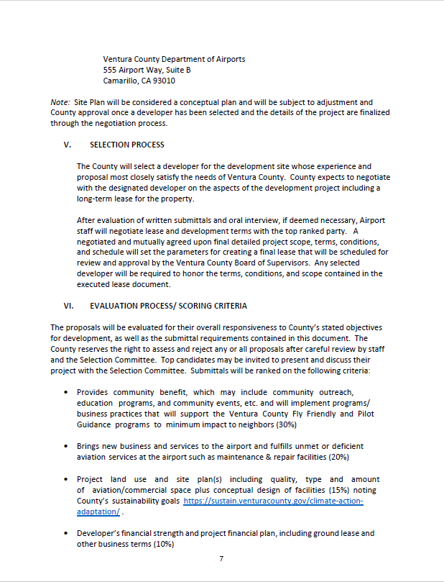
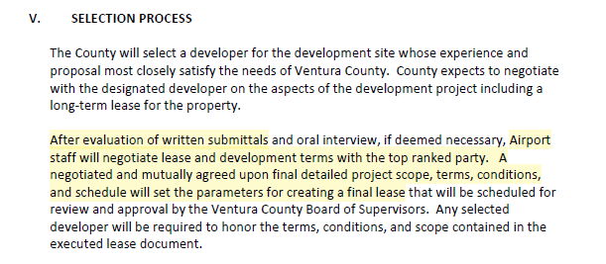
Negotiation – Final Detailed Project Scope & Terms

Slide 17
2026 | NEXT STEPS:
June 16th | Airport staff share rankings at an Open House
July | Airport staff present rankings at the AAC/CAA meetings
July/August | Airport staff begin lease negotiations with top ranked candidates
October/ November | Airport staff brings proposed lease to AAC/Authority for consideration
December/ January | Bring proposed lease to Board of Supervisors for approval
What happens next?

Slide 18
TOP FACTS
Regarding Misinformation &
Frequently Asked Questions

Slide 19
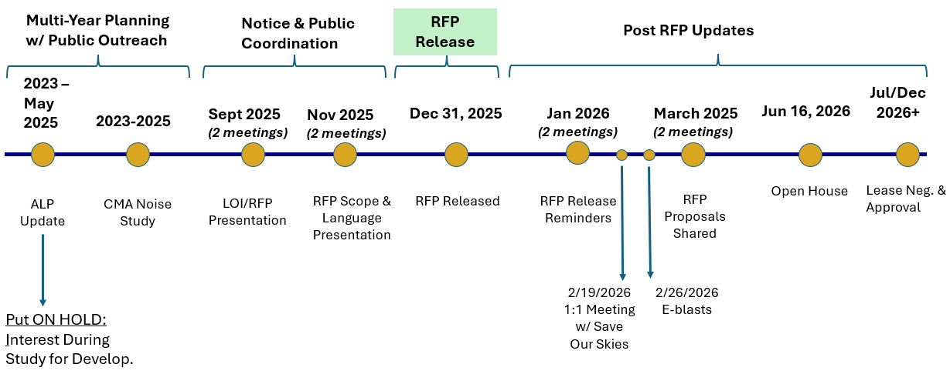
Rumor is that the Airport didn’t provide an opportunity for public input and rushed this RFP process?
Fact: Timeline shows we did not rush the process and were very transparent.

Slide 20
Rumor is the Airport is focused on expansion.
Fact: The Airport continues to be consistent with the JPA (no expansion of runway, no commercial airline service, and no large air cargo). We also remain consistent with the 2011 Airport Master Plan, the 2025 Airport Layout Plan Update and 2025 Airport Noise Study. However, we also have federal obligations to meet aviation transportation demands.

Slide 21
Rumor is the Airport is giving preference to larger aircraft and reducing parking for smaller aircraft.
Fact: Not true. Any proposal that includes removal of the existing small hangars, is required to replace the hangars in similar number/size at a new location.
Aviation forecasts reflect the majority of airport operations in 20 years remain single engine, smaller aircraft.

Slide 22
Rumor is that the developer will build the big hangar and then never build the smaller general aviation hangars.
Fact: Lease terms will require the developer to complete the replacement of smaller hangars before construction on the larger hangars will be approved.

Slide 23
Rumor is that the Airport is trying to bring more jets, the idea that if we build it, they will come.
Fact: We are not. Existing businesses solicited the Airport to build additional hangars to accommodate current demand.

Slide 24
Rumor is that Ventura County can just say no to future development, no to jets, no to piston airplanes and no to helicopters.
Fact: No. The Airport is obligated under the original 1977 Deed & Grant Assurances to participate in the national transportation system. The Airport is also prohibited from discriminating against type of aeronautical activities where opportunities exist.

Slide 25
Rumor is that the project will bring more jet traffic to CMA. Specifically, it is claimed that the Top Ranked proposal for the 4.1 acre site will increase new large jets at Camarillo Airport by 20-40.
Fact: The 4.1-acre site could reasonably accommodate 10 jets, as is seen with similarly-sized properties already in use. However, the Top Ranked Proposal (Air7) has indicated that they want to use a percentage of the new larger hangar space for existing tenants and the remaining space for a new MRO which will keep based jet aircraft from having to fly out and in empty for repairs.

Slide 26
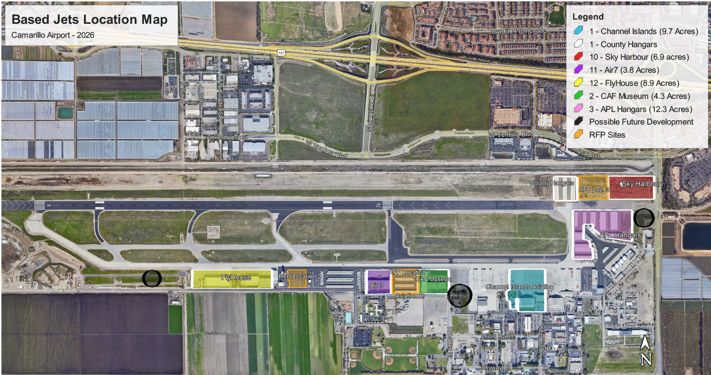

Slide 27
Rumor is the Top Ranked developer for the 4.1 acre site plans to immediately turn around and sell the lease and that any obligations made will not be upheld.
Fact: Not true. And, even if this were to happen, the lease will include language that protects the interests of the Airport and the public where transfers of ownership occur. New owners assume the original obligations and security requirements.

Slide 28
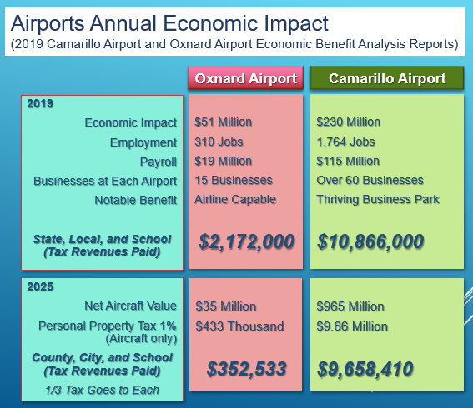
Rumor is the City of Camarillo and its Citizens do not see financial benefits from the Airport, only the burden.
Fact: Camarillo Airport contributes in many ways to the City, community and County; through public services (Fire service, Caltrans, Sheriff) and direct economic benefits.

Slide 29
Community Q & A

Slide 30

Community Q & A Format
To submit a question, complete the question card.
Raise your hand when complete and a project team member will collect your question card(s).
Your question(s) will be read by the moderator and answered during the Q & A.
You can voice a question (2 min.) after all question cards have been read and answered.
One voice question per person. Once everyone who wants to voice a question has done so we can return to you if you have another question you’d like to voice.

Slide 31
Code of Conduct
The County is committed to ensuring that all participants can fairly and clearly share ideas, comments, and concerns about this project and the Camarillo Airport. To provide a safe and equitable process, please remember to:
Treat each other with kindness and respect including your neighbors, the moderators, and the panel.
Respect the format of the meeting.
Maintain a conversational tone.

